Slide 1


1
BUDGET SALES ANALYSIS

Slide 2
What is Budget Sales Analysis?
2
This Budget Sales analysis will examine the budget data of “Adventure Works” Database.
The goal is there to create a dashboard that will measure the company performance.
It will focus majorly on the sales of different categorical products in different territorial region .
The sales in year 2016 in all twelve months.

Slide 3
Databases used!!
3
Budget database
Adventure Works
Sales
Customers
Products
Territory

Slide 4

Budget Database
Adventure Works: Products
Category
Sub-Category
Product Name
Product Key
Sales from Jan2016 to Dec2016
Category
Sub-Category
Product Name
Product Key
Colour
Standard Cost
List Cost
Product Line
4
Adventure Works:
Territory
Adventure Works: SALES
Adventure Works: Customers
Product Key
Customer Key
Promotion Key
Sales Territory Key
Order Quantity
Unit Price
Total Product Cost
Sales Amount
Tax Amount
Customer Key
Full Name
Birth Date
Martial Status
Number of Children
Number of Cars Owned
Yearly Income
Gender
Education
Occupation
House Owned Flag
Sales Territory Key
Region
Country
Group

Slide 5

GLANCE OVER THE DATA
5
There are total 11 Territories under North-America, Europe and Pacific group.
Sales data of 3 Categories – Accessories, Bikes and Clothes of year 2016.
Customer Details with unique Customer Key.
Product List sold along with customer key and tax details during sale.

Slide 6
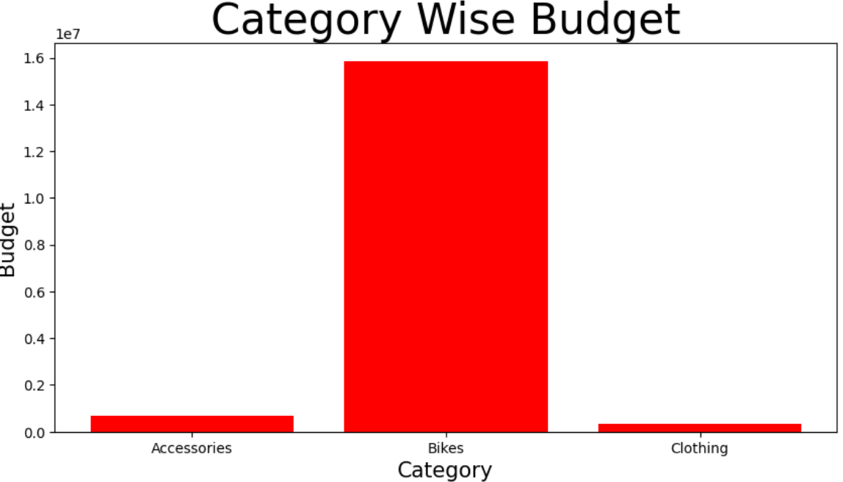
Category wise budget sales
6
2016
According to the analysis:
Bikes has the highest sale in 2016 while
Clothing has the lowest sales.

Slide 7
Sub-Category wise budget sales
Bikes…
7
Accessories…
Clothing…
Maximum Sales
Mountain Bikes
Bottles and Cages
Jerseys
}
477
344
226
Product Key

Slide 8
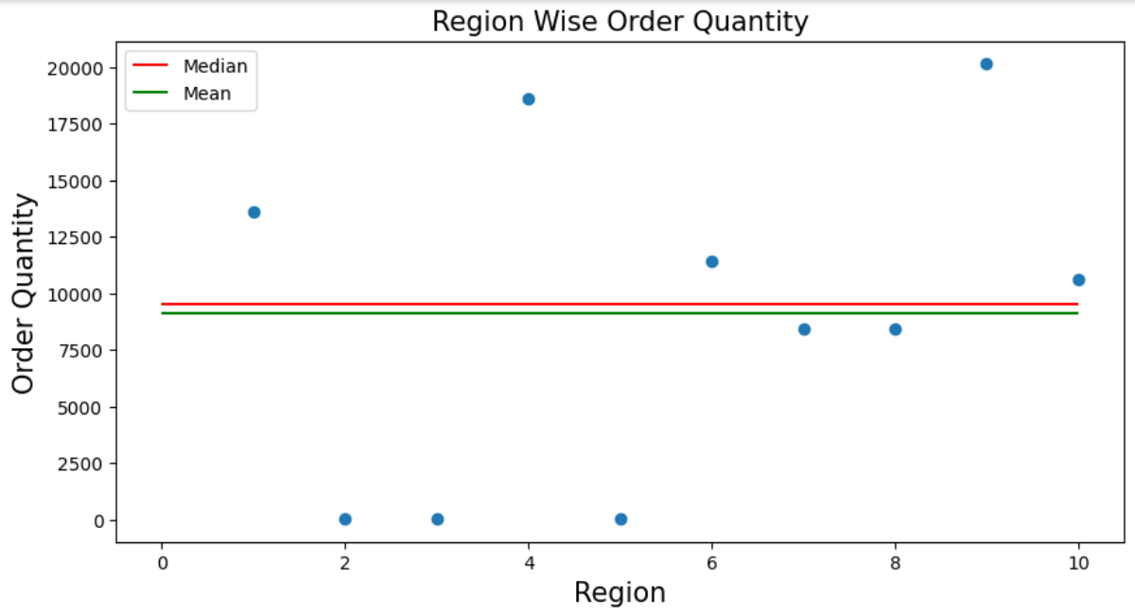
Territory Wise sales
8
Maximum number of orders came from Region 9 –> 20140 orders.
Minimum number of orders came from Region 2-> 35 orders.
Average orders are between 8000 to 9500
Region 9: Australia
Region 2: Northeast

Slide 9
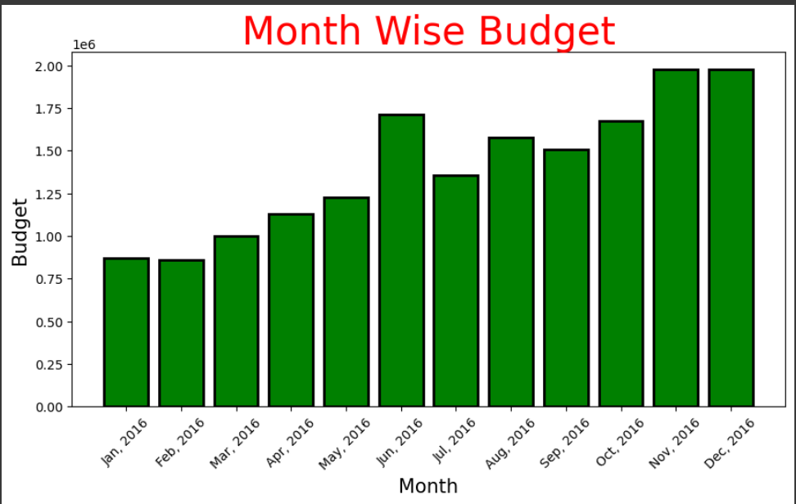
Monthly Analysis
9
2016
According to monthly analysis of 2016, highest sales/budget happen in month November and December
While
Lowest sales/budget happen in month January and February.

Slide 10
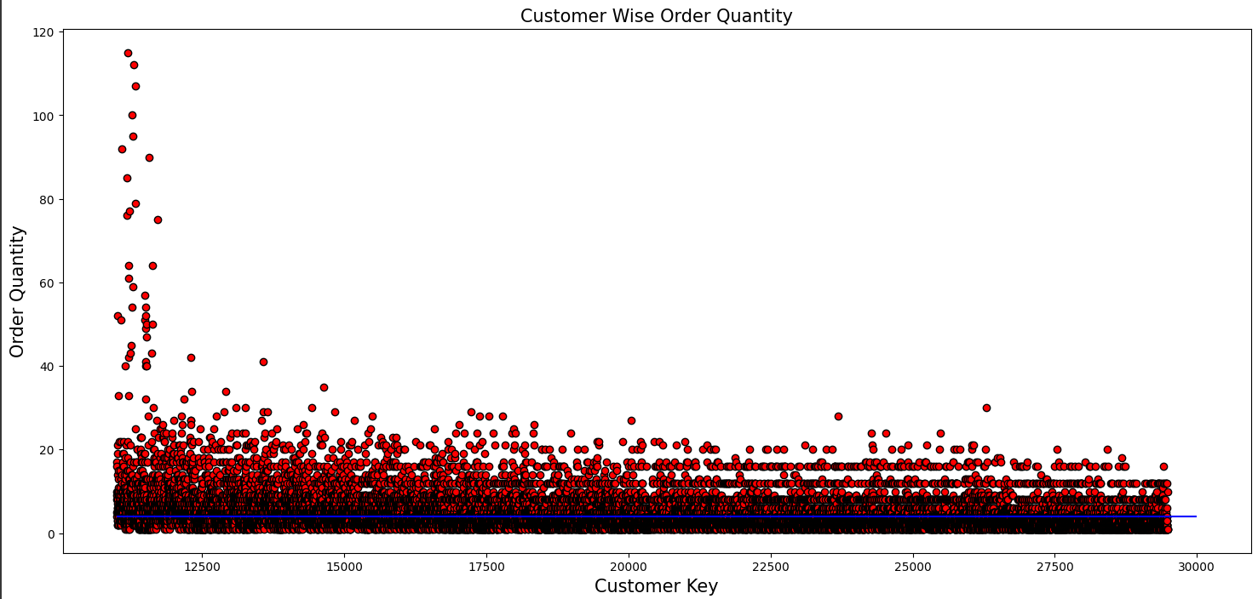
Customer Analysis
Average of orders is 4.
10
Highest Orders were from customer with following details:
Customer Name: Griffin Jason
Martial Status: Married
Gender: Male
Yearly Income: 70000
Occupation: Management

Slide 11
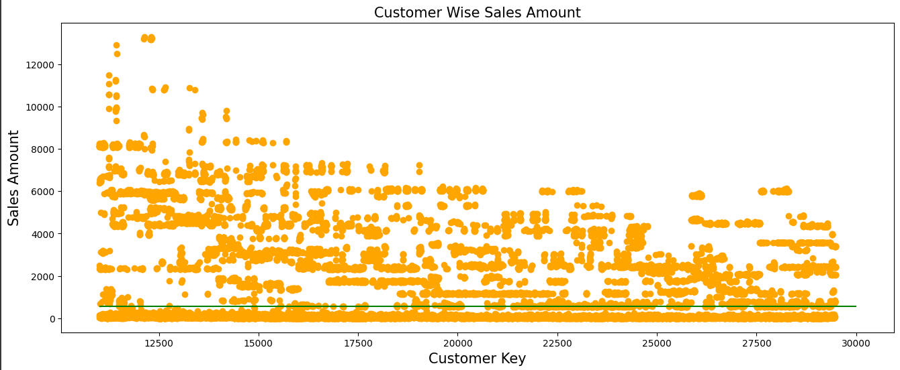
Customer Analysis
Average of Sales amount is 548.98.
11
Highest Sales-Amount was from customer with following details:
Customer Name: Nara Nichole
Martial Status: Single
Gender: Female
Yearly Income: 100000
Occupation: Management
Number of Cars Owned: 4

Slide 12
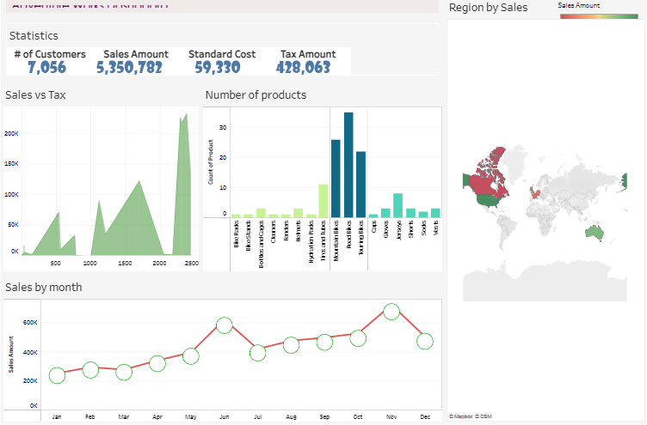
DASHBOARD
12

Slide 13
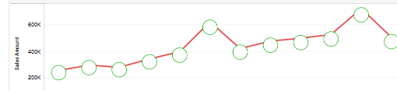
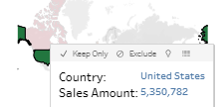
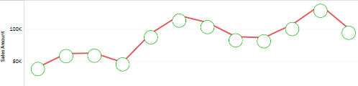
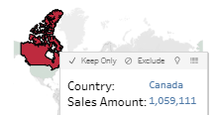
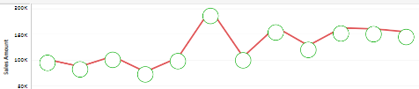
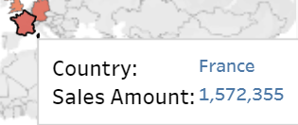
12
Region: United States
Region: Canada
Region: France

Slide 14
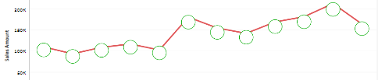
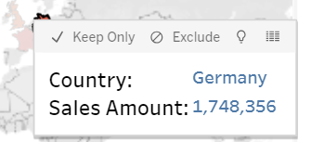
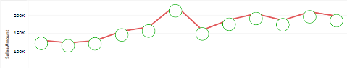
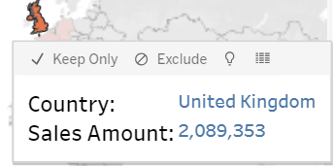
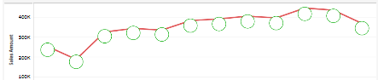
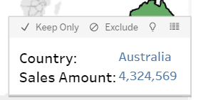
12
Region: Germany
Region: United Kindgdom
Region: Austratlia

Slide 15

Conclusion
The customer with highest sales order own 4 cars and have 100000 income i.e., financial stable customer and buy good quality product
The customer with highest orders have average earning.
Australia is the biggest customer among all regions in 2016.
Average of sales around 548 while average of orders is 4.
November and December are the months with highest sales in 2016
Bikes are most expensive with highest sales and highest orders products.

Slide 16

Thank You

